Slide 1
The Nucleus’ Physical Role in Collective Cell Migration
Presented By: Brady Hine
Notes:
Hi, I’m Brady and this is my mid semester update presentation for my project investigating the nucleus’ physical role in collective cell migration.

Slide 2
Introduction
Significance
Problem
Cell repopulation
Wound healing
Developmental tissues
Collective migration
Nucleus limiting factor
Scratch wound assay
Notes:
Collective cell migration is a necessary function for many biological processes to work effectively including, but not limited to, repopulation of cells after tissue engineering, wound healing mechanisms, or formation of developmental tissues. The nucleus’ importance in this is that it serves as a limiting factor for migration due to it often being the largest and stiffest organelle in the cell. To investigate the effects of these impacts on collective cell migration a scratch wound assay model is being used where a layer of cells is cultured, a scratch is applied, and time lapse imaging of the healing process is then used to quantify migration parameters.

Slide 3
Specific Aims
Aim #1
Establish a scratch wound assay of cell migration using NIH-3T3 cells
Migration quantification and validation
Y27632 (myosin contraction inhibition)
Aim #2
Observe how changes to nuclear mechanics affect migration parameters
Modify stiffness and chromatin remodeling
Trichostatin A (HDAC inhibition) and GSK126 (EZH2 inhibition)
Notes:
That leads me to the specific aims for this project. The first of which being to establish the scratch wound assay that will be used to conduct these experiments. This aim will also include determining methods for quantifying migration as well as validating the setup by using the migration inhibitor Y27. The second aim for the project will involve observing how changes to nuclear mechanical factors impacts the quantified migration parameters. Modifying the nucleus will be done by applying GSK and Trichostatin A which will affect chromatin remodeling and nuclear stiffness.

Slide 4
Specific Aims
Aim #3
Perform live imaging of the cytoskeleton and nucleus at high resolution to quantify a strain map in the cell monolayer.
NucBlue (nucleus) and Lifeact (actin)
Future Work
Investigate interactions between nuclear mechanics with substrate mechanics and cell crowding
Notes:
The last specific aim for this project will involve using live staining and imaging of the nucleus and actin cytoskeleton during the scratch wound assay. This data will then be used to develop a strain map at the cell monolayer level providing detailed mechanical insight into the migration process. If these aims are successfully met, it’d help lay groundwork for looking into interactions of nuclear mechanics with cell crowding effects and substrate mechanics as well as adaption of the assay to MSCs.

Slide 5
Fall ‘21 Progress
Assay Setup
Confluence timing (2-3 days)
Scratch Methodology
Imaging timeframe (~12 hours)
Cell Staining
Fixed: nucleus (DAPI) and actin (phalloidin)
Live: nucleus (NucBlue) and actin (Lifeact)
Notes:
Efforts last semester focused on the first aim of establishing the scratch wound assay. This included determining cell culturing time, scratch methodology, and the imaging timeframe required for optimal imaging of the migration process. Work was also done establishing cell staining methods and timing for the nucleus and actin in both live and fixed cells. The two images here help visualize some of the progress made with the left being the first scratch attempt with no migration compared to the right with cleaner edges, cell staining, and migration observed.

Slide 6
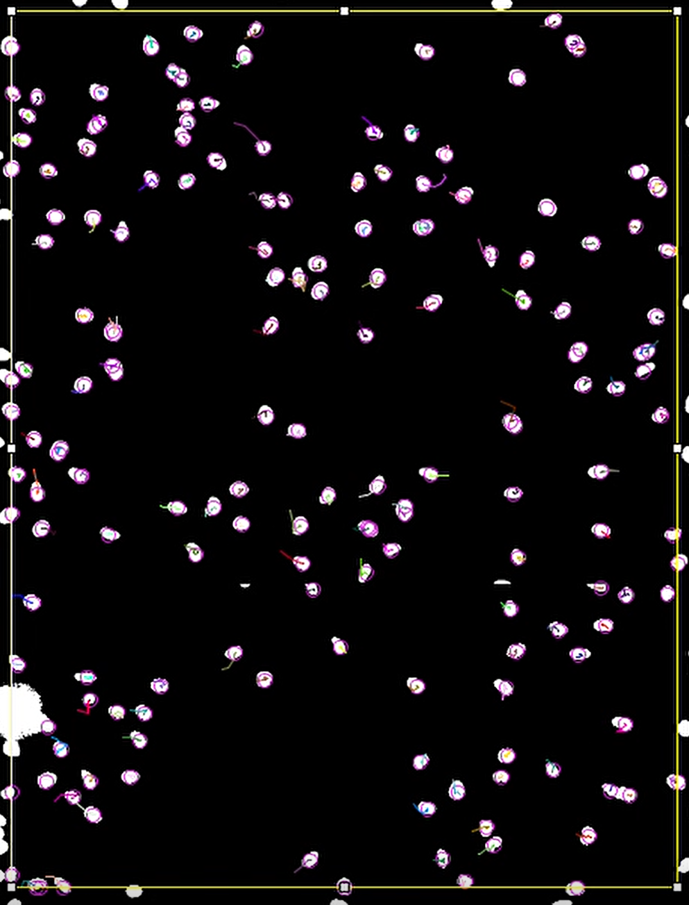
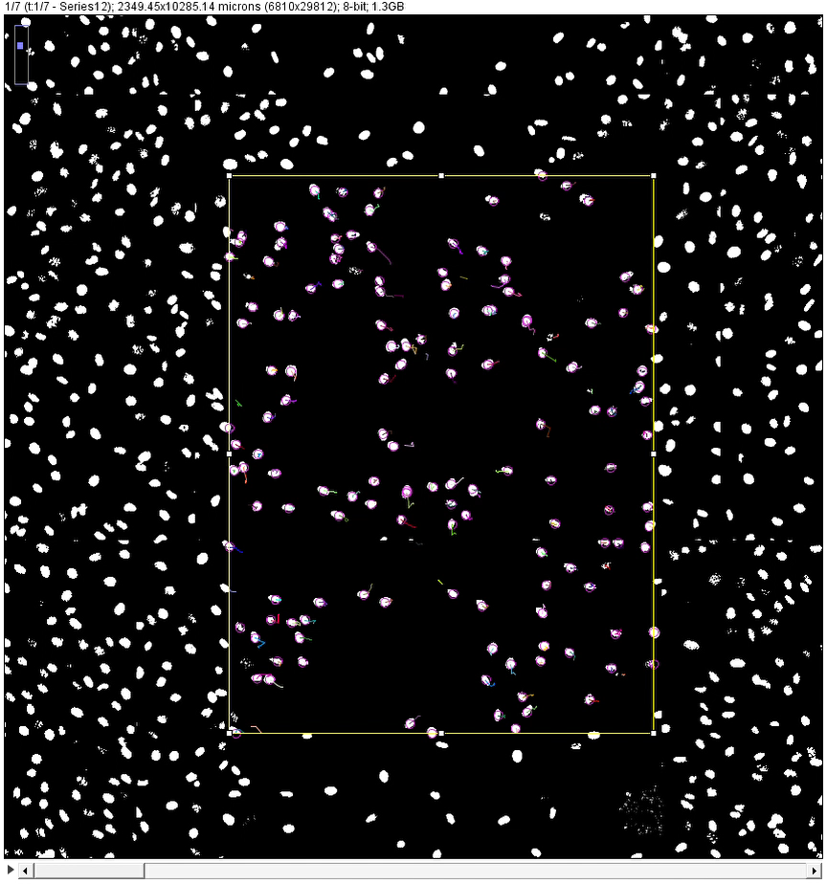
Fall ‘21 Progress
Image Processing
Automated cell tracking
Path calculations
Single well dataset
Notes:
At the end of last semester, an automated cell tracking method was established by using ImageJ and TrackMate. An output sample is shown here to visualize what the software is doing. Here, the white spots are stained cell nuclei, the spot detection is shown as purple rings, and the cell paths over all frames are shown as the colored lines. This then allows us to collect cell specific data of the collective migration process using path calculations. Before the proposal presentation last semester, this setup was used to collect some initial control data from a single well.

Slide 7
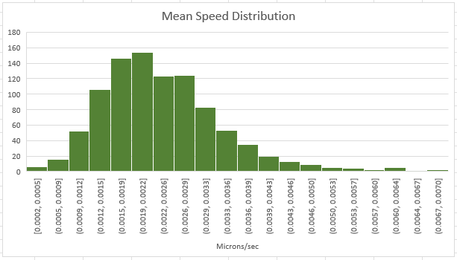
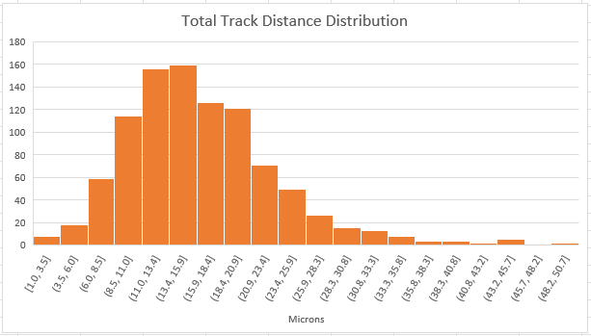
Fall ‘21 Progress
Notes:
These were a couple of the charts generated from that data, and presented during the proposal presentation, which revealed a fairly skewed distribution of migration parameters in a single wound. Originally, tabulated data was being characterized with means and standard deviations but from committee feedback, a median based approach was adopted for the future datasets.

Slide 8
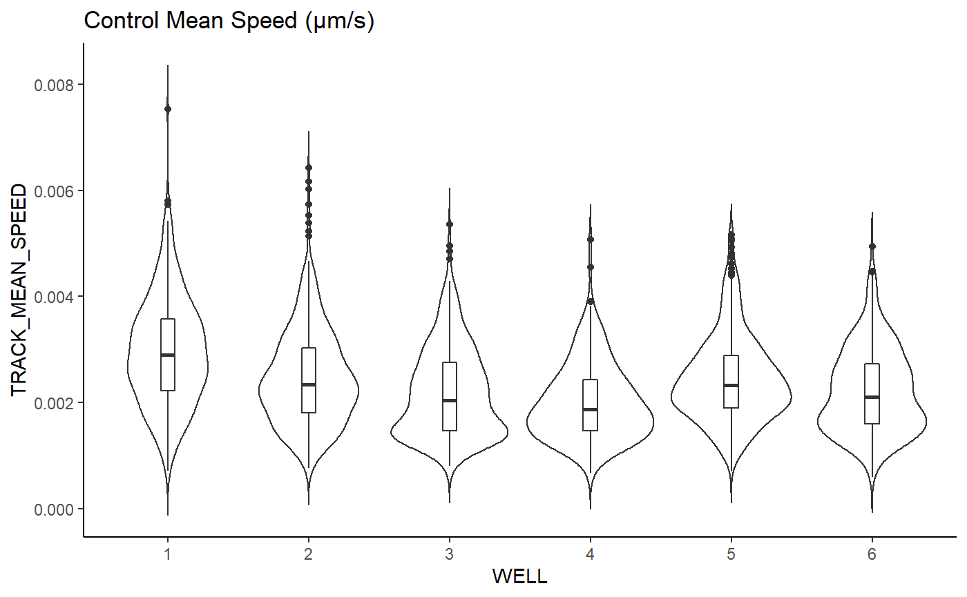
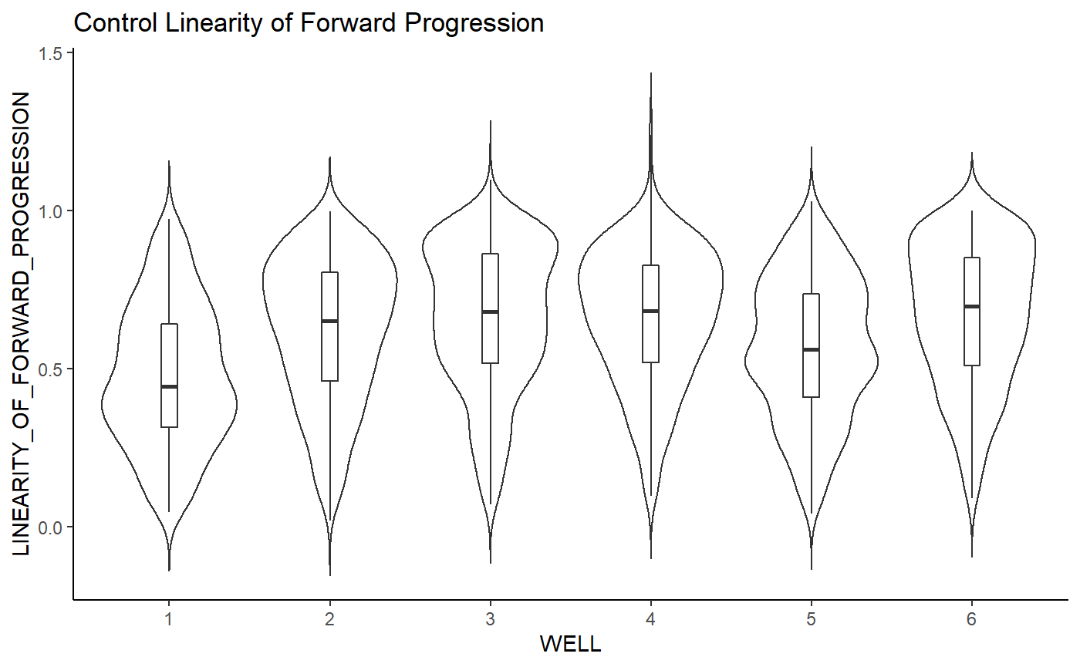
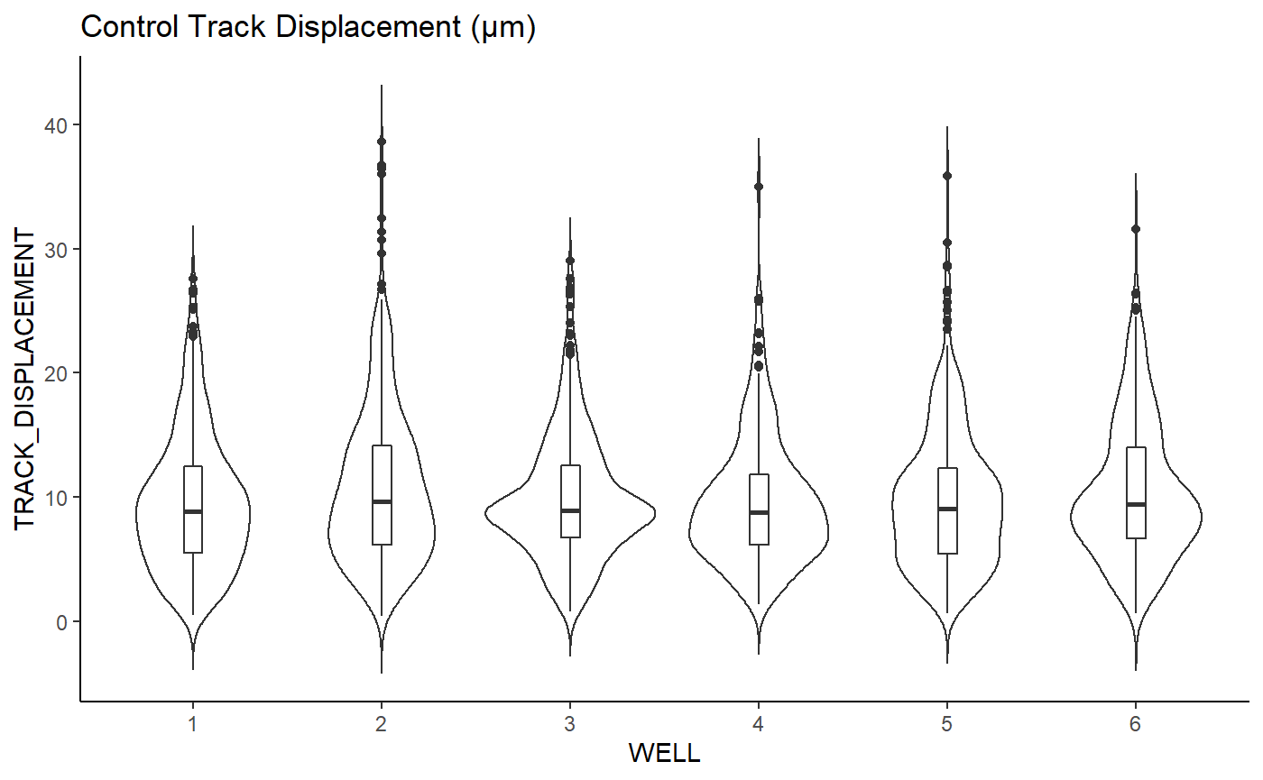
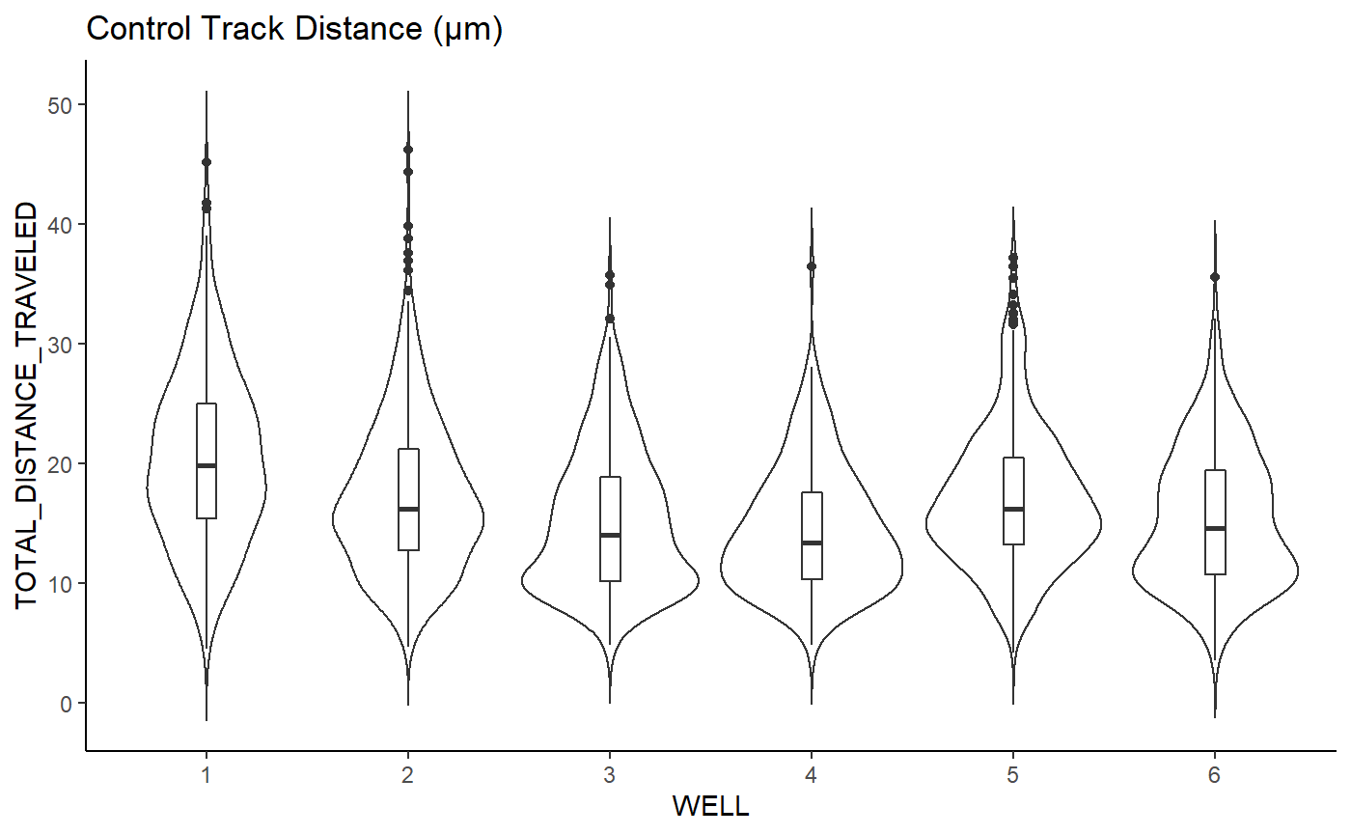
Spring ‘22 Progress
Control Data Collection
6 well dataset
Parameters of Interest
Mean Speed
Fwd. Progression Linearity
Track Displacement
Track Distance
Notes:
This approach allowed us to generate violin plots this semester, to represent the migration data for our parameters of interest for six control wells shown here. These plots are similar to box and whisker plots with showing a median and IQR, except they also visualize the data distribution along the sides of the plots. This graph represents mean speed of the control cells across 6 different wells and shows that the control cells exhibited similar speeds in the wound from well to well. This plot shows the linearity of forward progression for migrating cells which had a larger variation between and within wells than mean speed. So, whether this parameter will be statistically useful for comparing cell treatments remains to be seen. The next two plots being track displacement and track distance show less variation from well to well similar to the mean speed. These plots serve as control data so further analysis will be done comparing these values to those taken after modifying nuclear mechanical properties to provide more useful insight.

Slide 9
Spring ‘22 Progress
Assay Validation
Multiple setbacks
Well plates: ibiTreat to ibi + collagen
Y27632 application (20μM)
Aim 2 Initial Treatments
GSK126 (20μM)
Trichostatin A (100 ng/mL)
Live imaging: 0-, 4-, 21-hours
Notes:
The next steps taken this semester focused on validating the scratch wound assay however, there were a few weeks of setbacks here. The first of which involved entire cell cultures dying during incubation even without any treatments. To remedy this, we tried using an earlier passage of the NIH-3T3 cells which had no affect leading us to believe there was a contamination issue. Thus, a deep clean of the cell culture room was done including water baths, fume hoods, and incubators which did fix the issue. After this, suppliers ran low on the ibiTreat well plates we had been using which are treated to provide cell adhesion sites. So, a different brand of plates was ordered but they ended up not fitting into the microscope well. An attempted fix was using the untreated ibi well plates and placing a collagen layer before seeding cells. This worked quite well and sped up migration to a point that when we checked at our normal time point after the scratch we couldn’t even find where the scratch was made. To increase throughput of the assay for validation and initial aim 2 data, an 8 well plate was seeded and treatments were done with Y27, GSK, and TSA at concentrations shown for 2 wells each with remaining wells being the control. Scratches were made and live imaging of the wounds was then taken at 0-, 4-, and 21-hour time points.

Slide 10
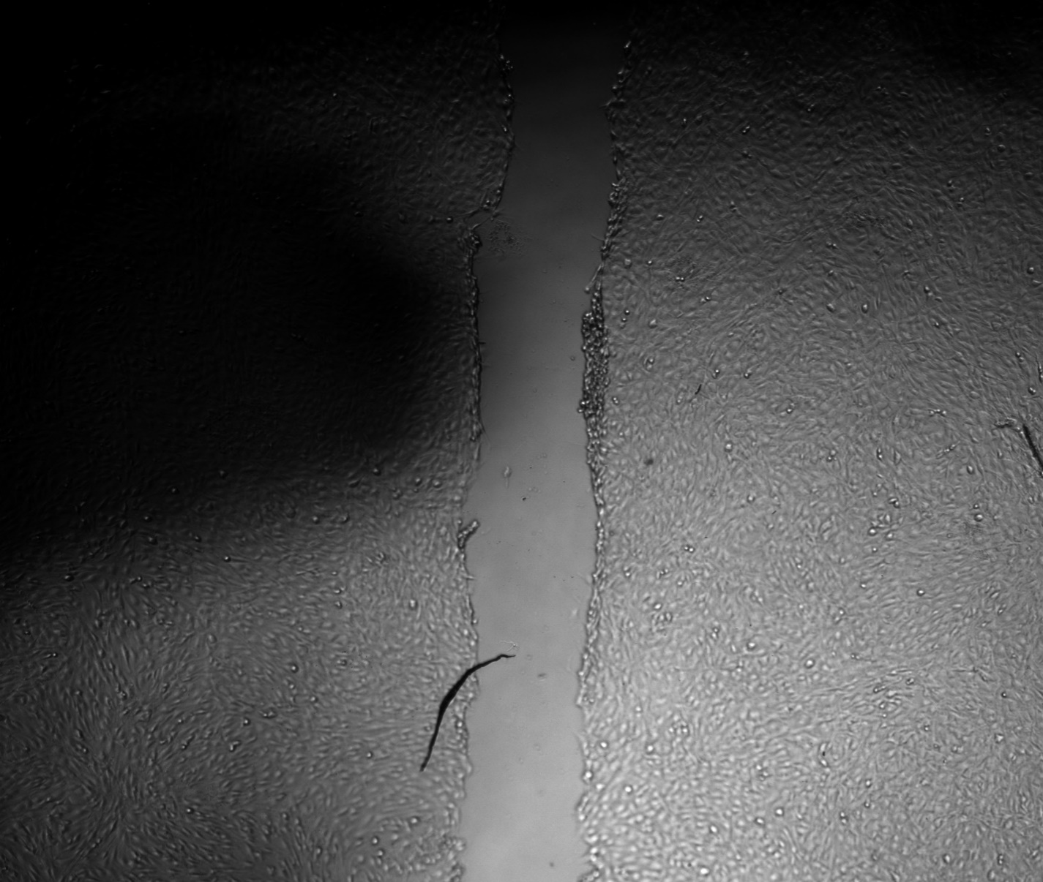
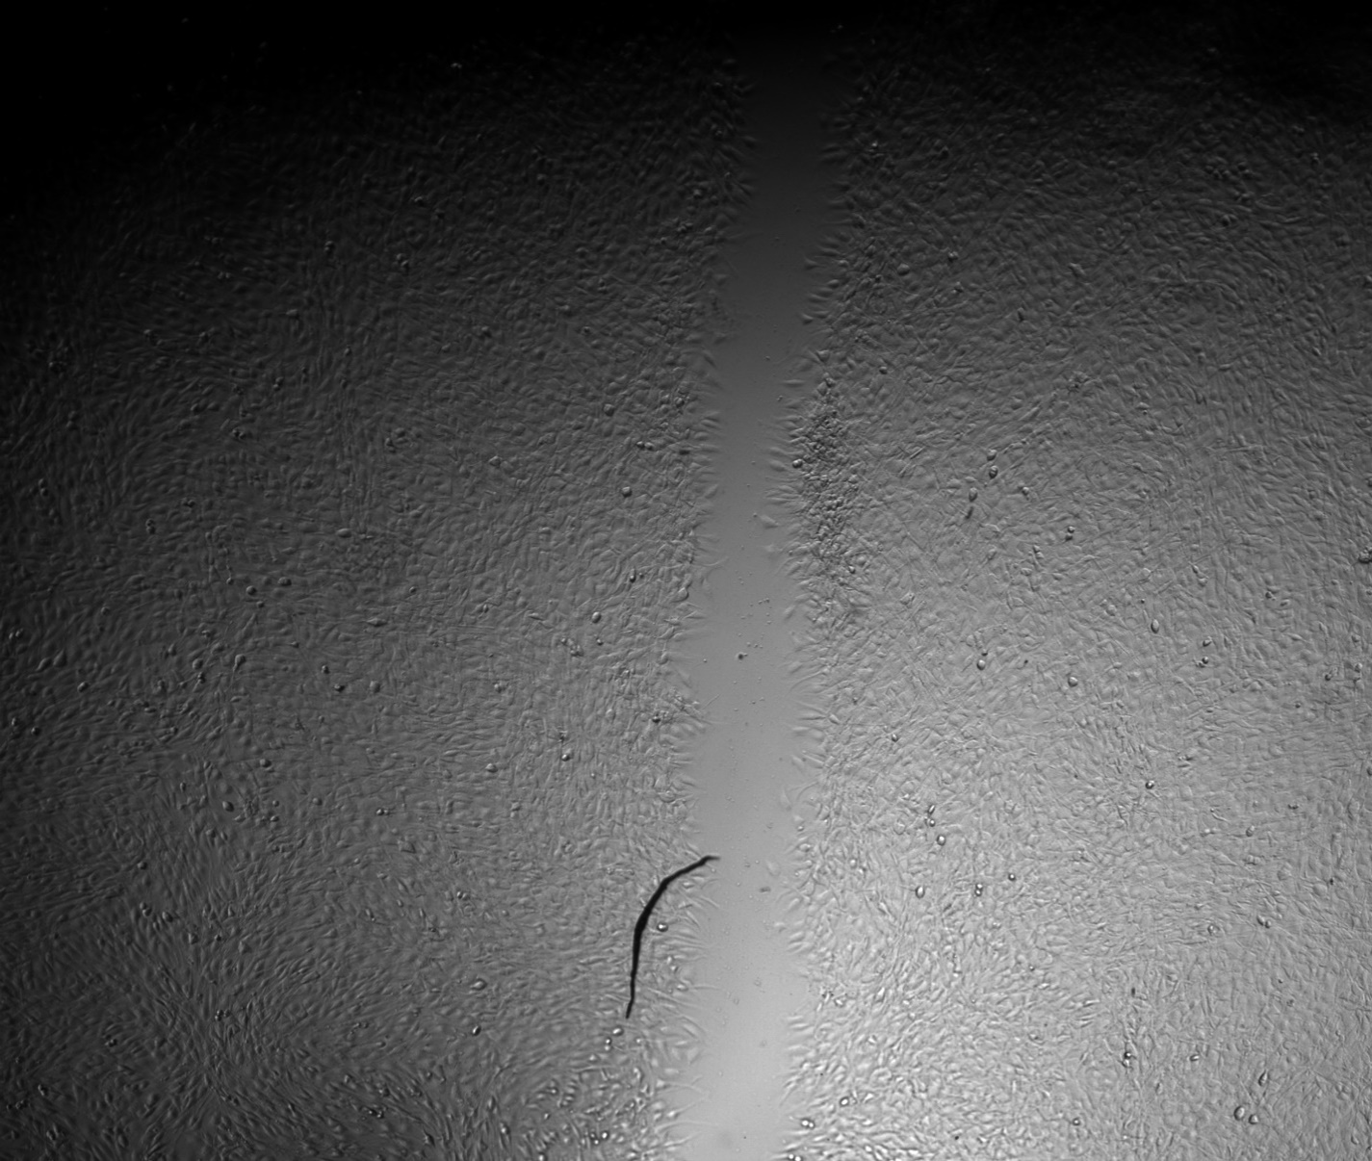

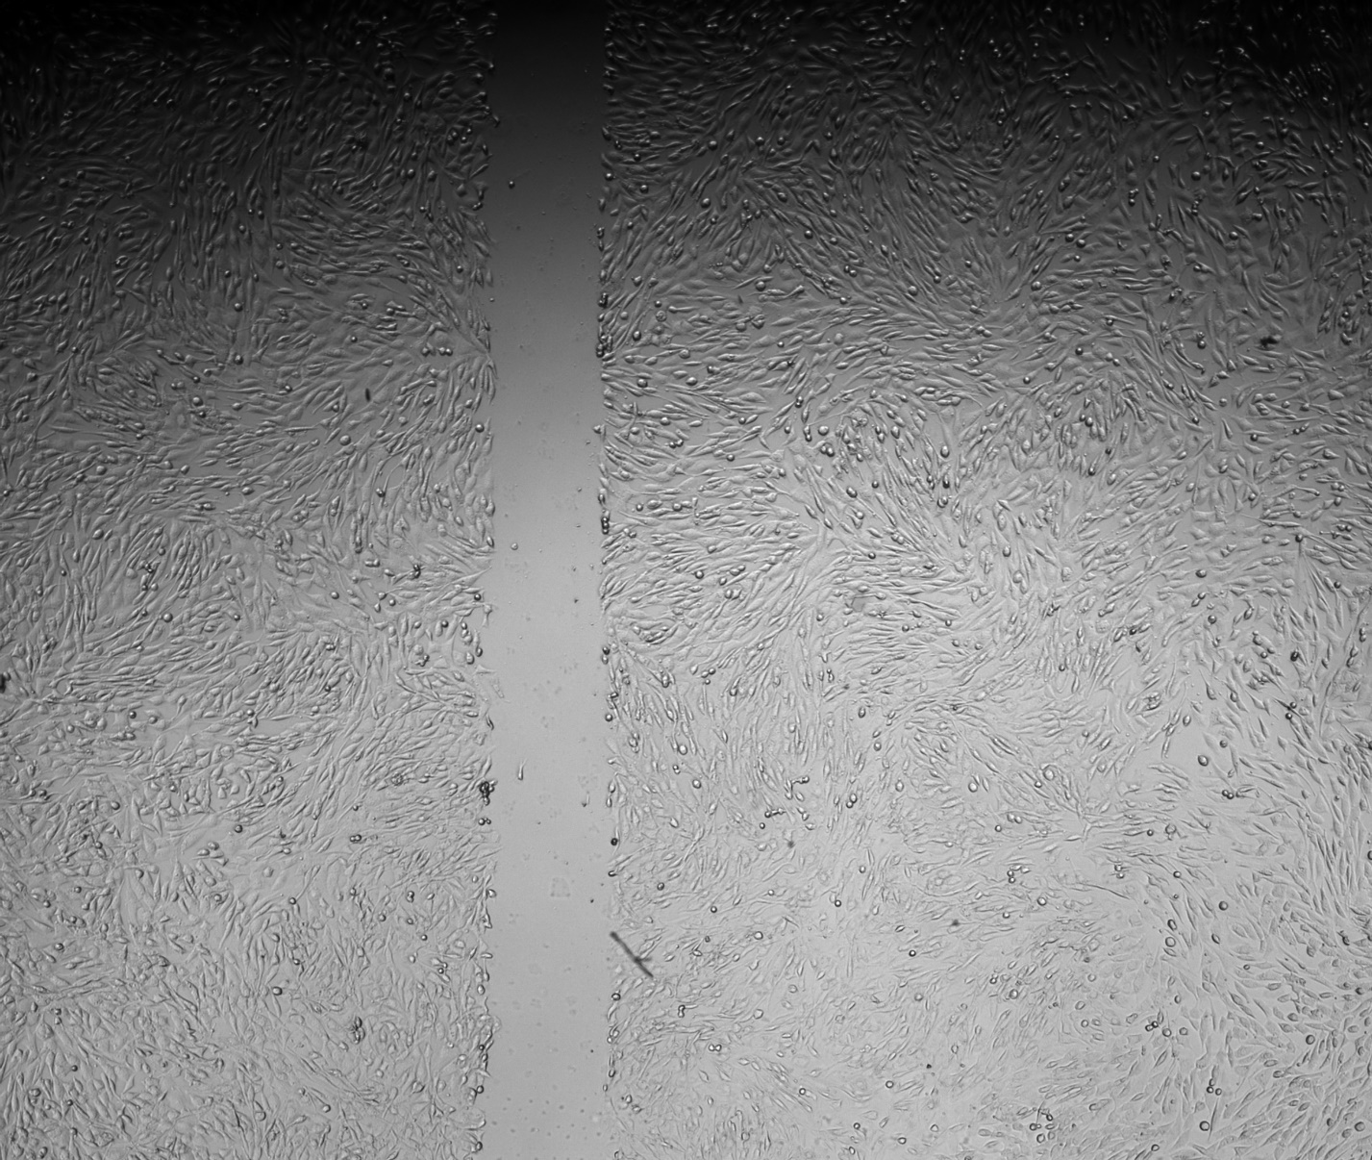
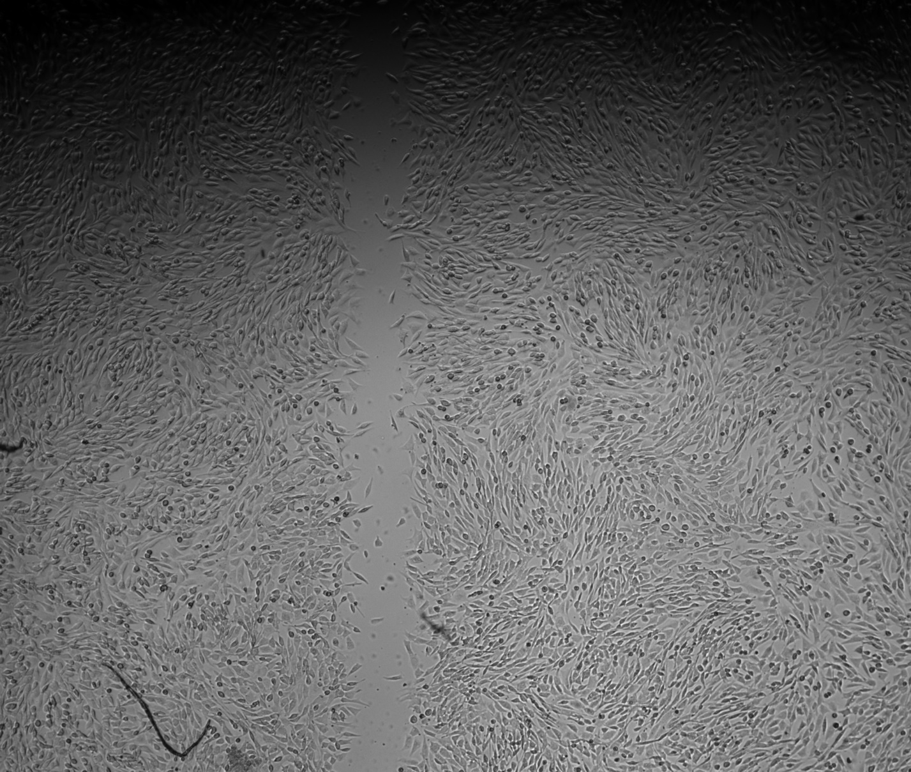
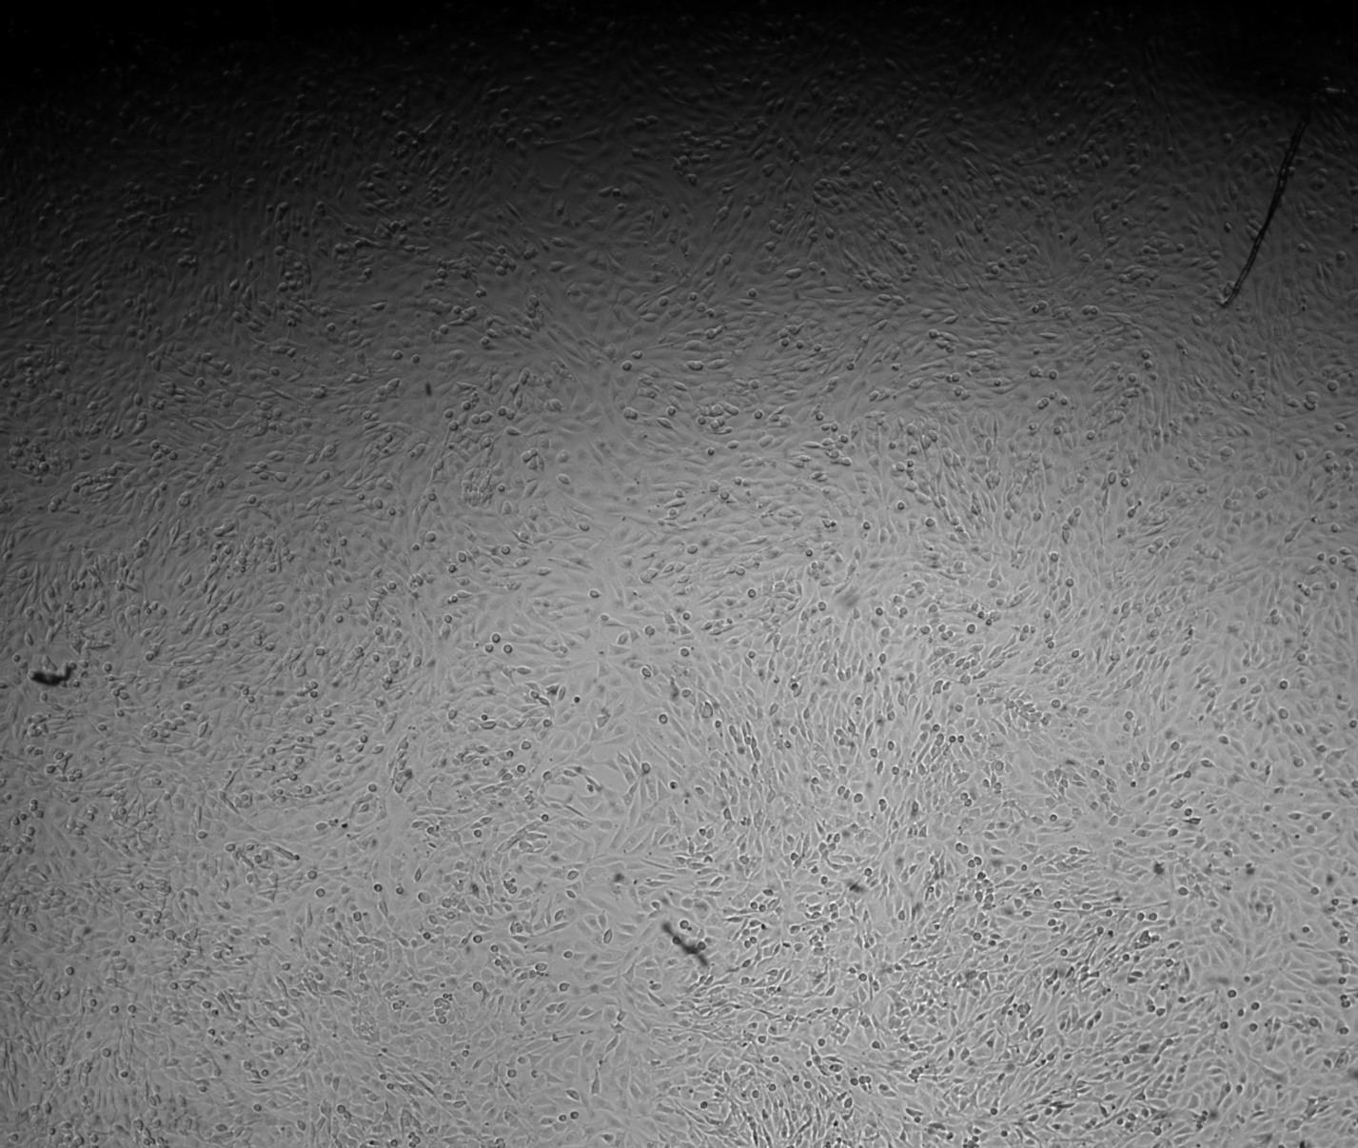
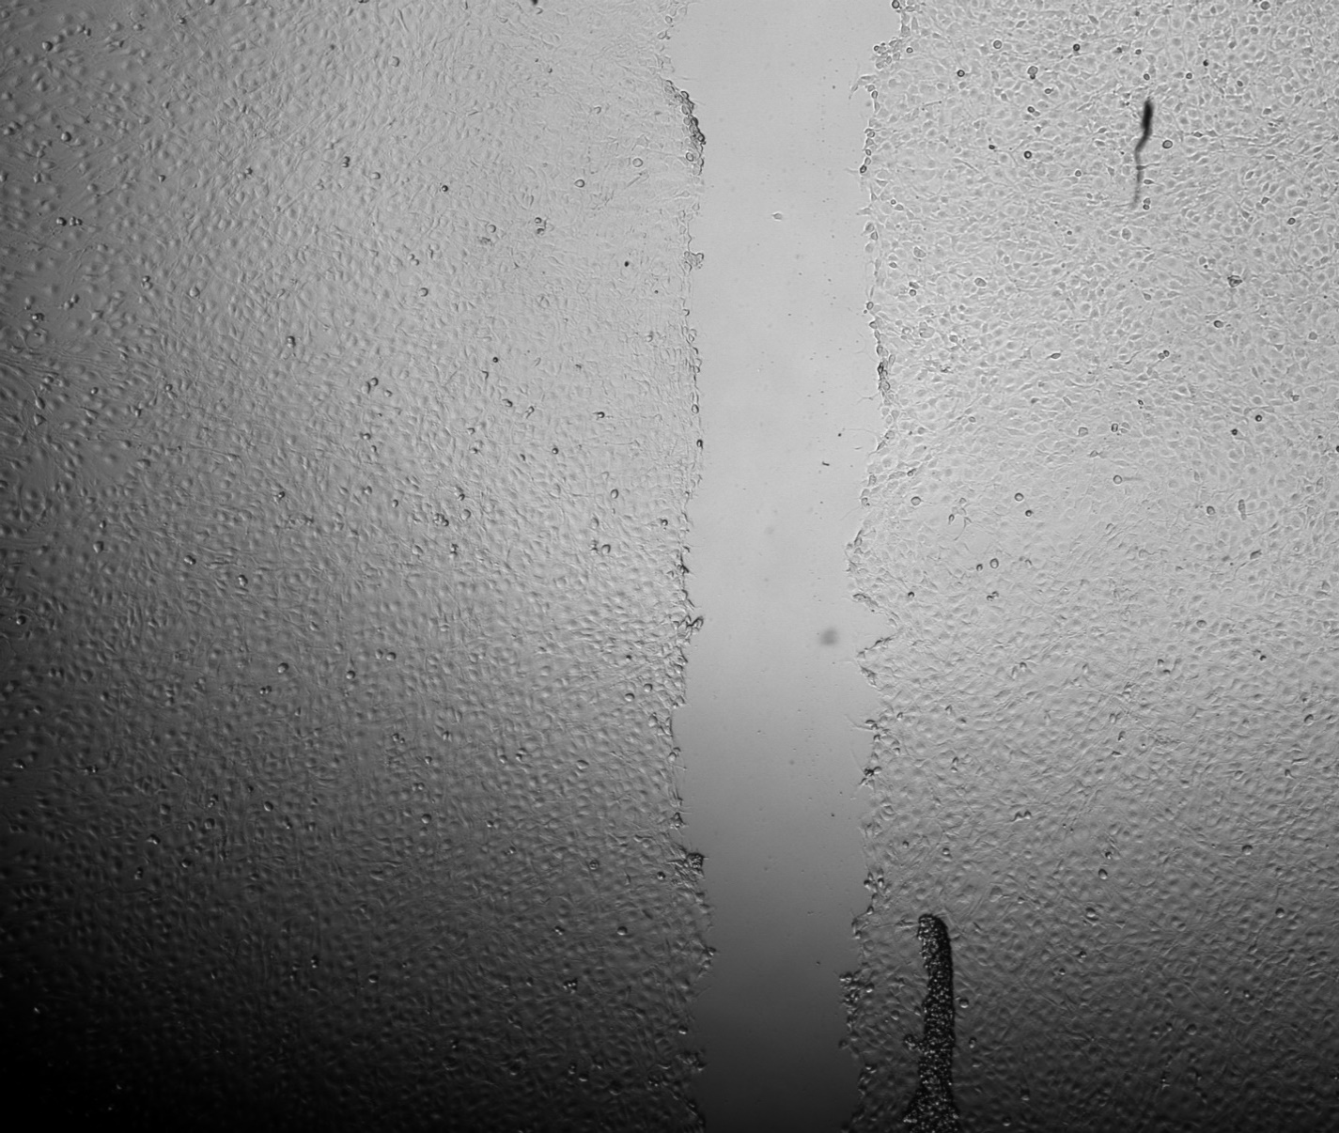
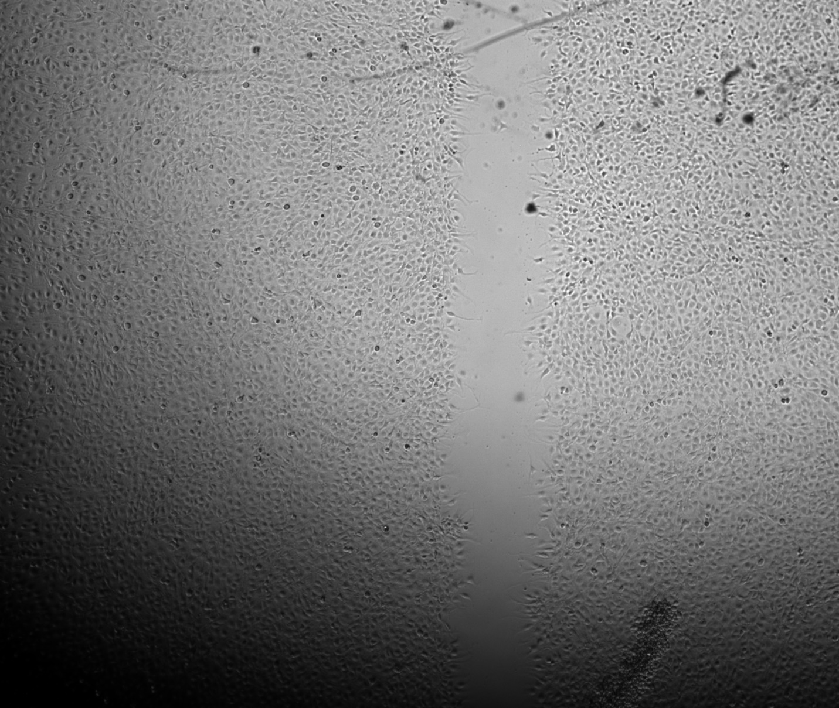
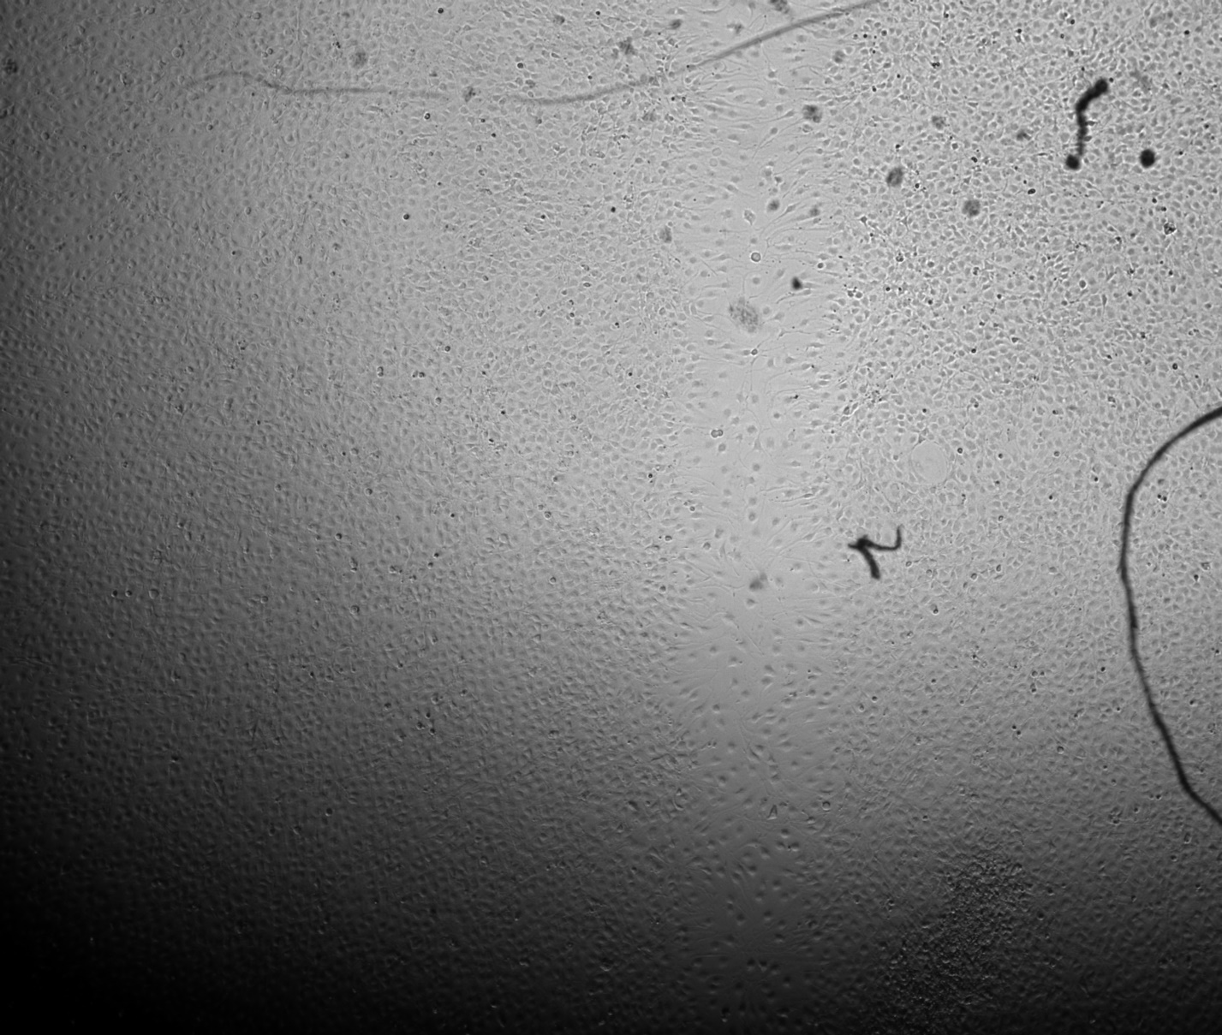
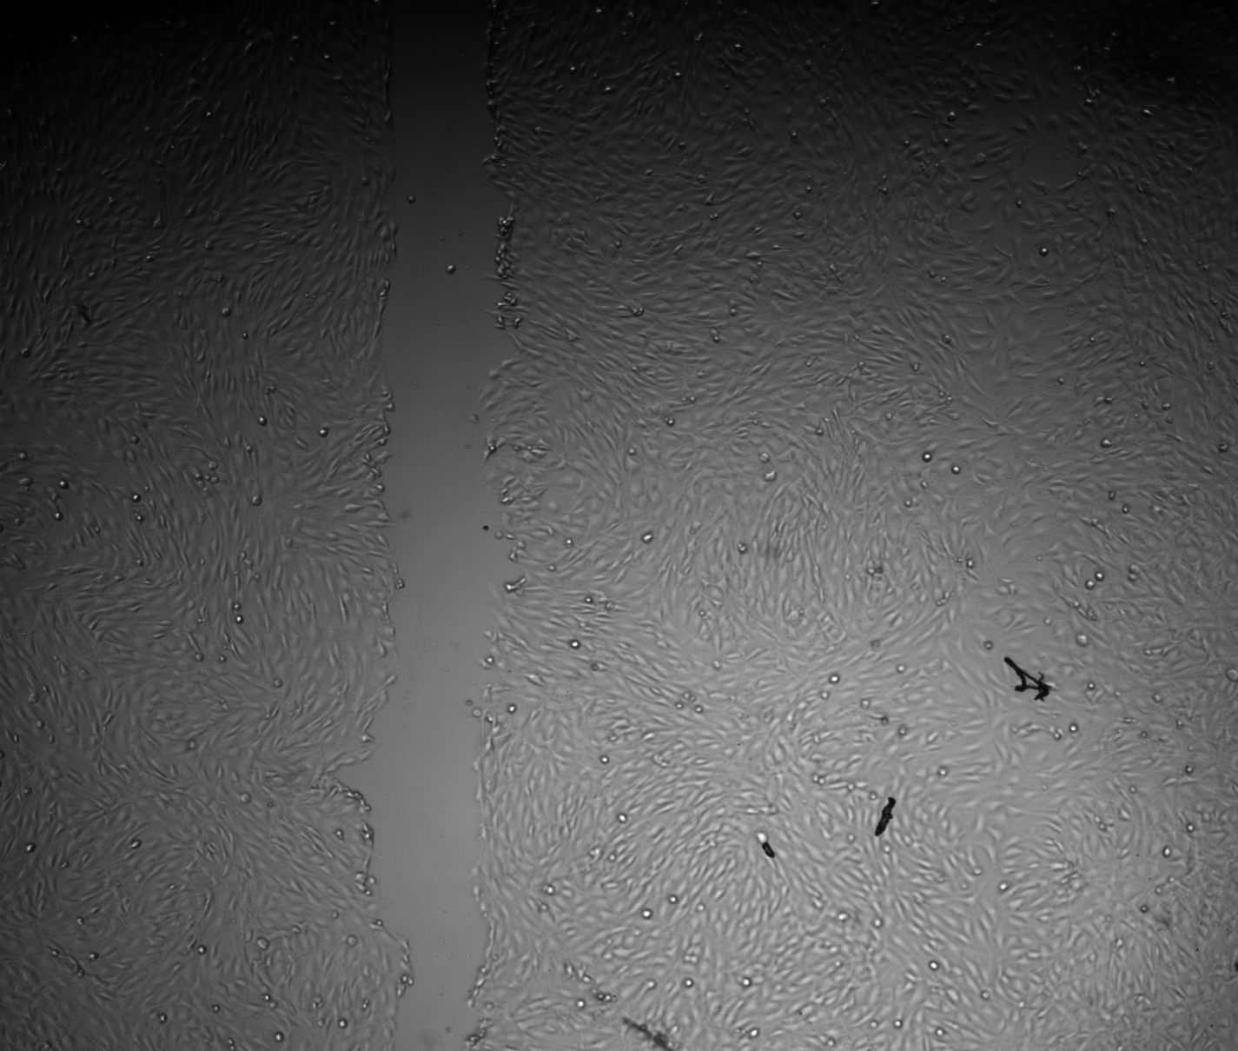
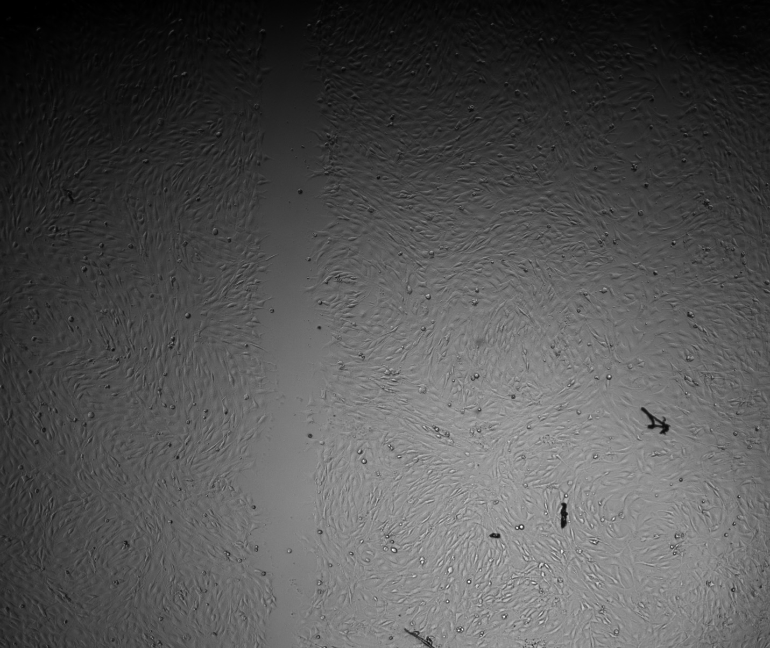
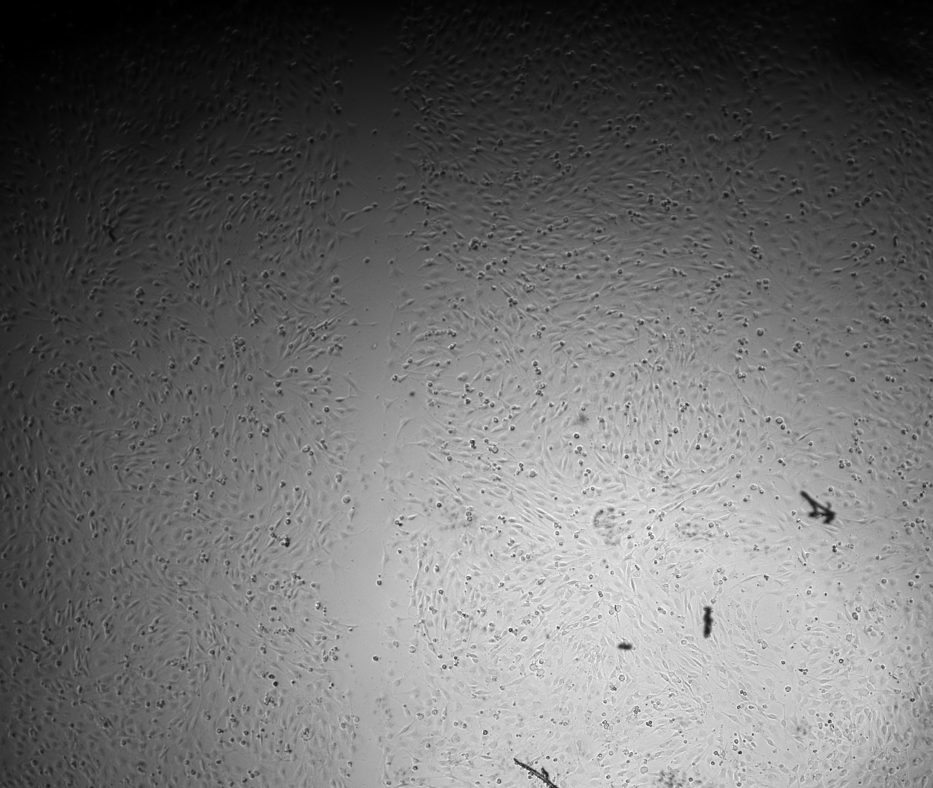
Control Group
20μM GSK126
200μm
200μm
0 hours after scratch
4 hours after scratch
21 hours after scratch
0 hours after scratch
4 hours after scratch
21 hours after scratch
20μM Y27632
100 ng/mL Trichostatin A
200μm
200μm
Notes:
Those images are then shown here starting with the control group on the top and the Y27 treatment group at the bottom. The left column shows immediately after the scratch application, the middle at four hours after the scratch, and the right at 21 hours after the scratch. Comparing these two groups we can see noticeably less migration with the Y27 treatment which was expected for validating the setup as Y27 is a blocker of actomyosin contraction. This group then shows the GSK treatment which appears to have increased the rate of migration compared to the control from a visual analysis which is really exciting. This is especially clear in the four-hour timepoints but even with the 21-hour timepoints you can faintly see an outline of the original scratch in some spots of the control where the same can’t be said for the GSK group. Lastly, here we see the TSA group which exhibited a large decrease in migration compared to the control with the amount of migration being even lower than that seen with blocking actomyosin contraction. These images show just one well per treatment group, but the same trends were seen in the other wells too.

Slide 11
Planned Work
Aim 2 – Full Assay
Automated cell tracking
Quantitative migration parameters
Aim 3 – Update
Predictive mechanobiological model
Nuclear mechanics input
Migration parameter output
Model research & creation
Notes:
Remaining planned work for the semester involves running the full assay for aim 2 with GSK and TSA and using automated cell tracking to gather quantitative migration parameters to compare with a control group. There has also been an update to aim 3 of the project as the strain mapping was already ambitious before the setbacks this semester making it no longer seem feasible. Thus, we are looking to change the aim from strain mapping to creating a predictive mechanobiological model for the migration using nuclear mechanics as an input parameter for a migration parameter output. Conducting modeling research for the aim has already begun with creation of the model being the final planned task before E-days.

Slide 12
Initial Timeline
Project GANTT Chart | December | January | February | March | April
1 – Aim 1 Validation
2 – Aim 1 Baseline
3 – Aim 2 Data Collection & Analysis
4 – Aim 3 Experiment Replication
5 – Aim 3 Strain Mapping
6 – E-days Preparation
Notes:
This table shows the initial timeline proposed for the project but as mentioned previously, some changes have been made.

Slide 13
Revised Timeline
Project GANTT Chart | December | January | February | March | April
1 – Aim 1 Validation
2 – Aim 1 Baseline
3 – Aim 2 Data Collection & Analysis
4 – Aim 3 Modeling Research
5 – Aim 3 Model Creation
6 – E-days Preparation
Notes:
This is our now revised timeline for the remainder of the semester with the areas in dark green showing completed tasks, blue for in progress, and yellow for yet to be started. At this point in time Aim 1 has been completed and Aims 2 and 3 currently underway with creation of the predictive model being the final task before E-days.

